Slide 1
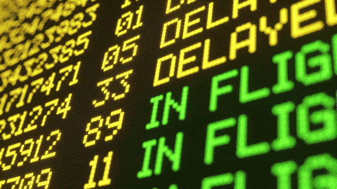
Flight Delay Predictor
max growth
LHL Midterm Project By:
Nitin Kohli
Gerard Agada

Slide 2
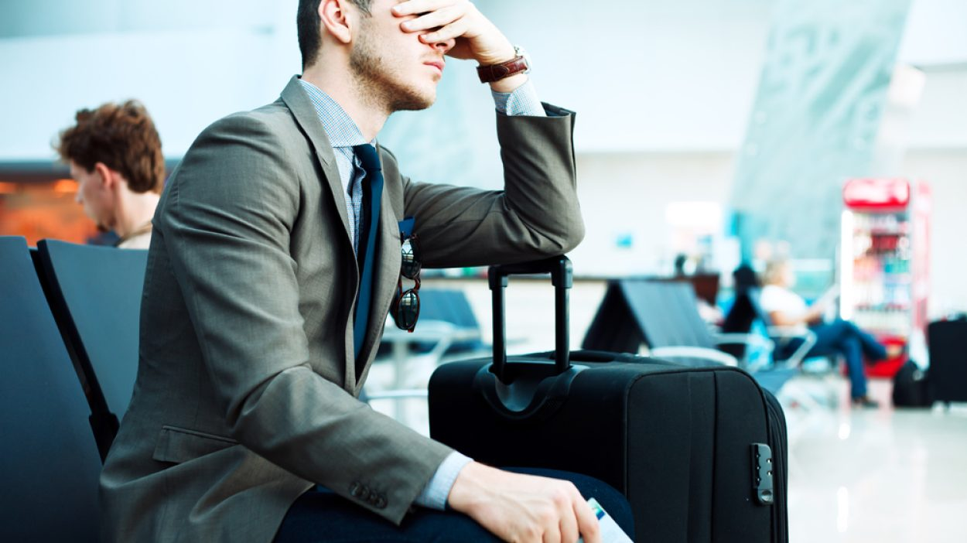
Why are Flight Delays Bad?
Costs A LOT of Money.
FAA estimated the annual cost of delays to be $28 BILLION in the USA alone.
Annoyed passengers.
Ruined plans.
Reduced customer base.
Make travellers to miss connecting flights.

Slide 3
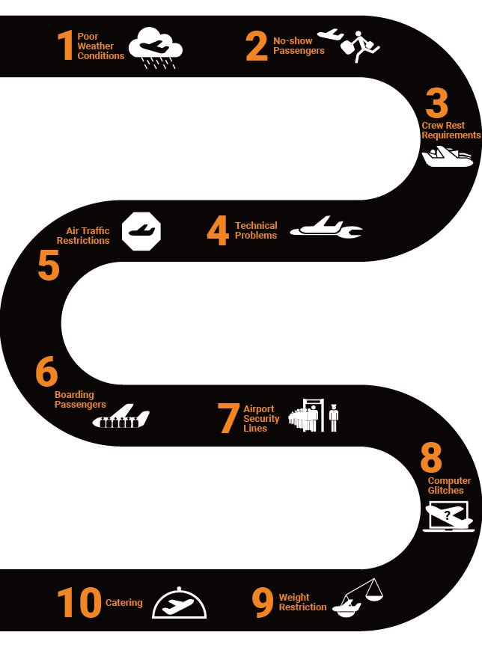
What causes a Flight to be Delayed?
Air Traffic Control
Adverse Weather
Security Clearance
Connecting Passengers
Reduced customer base.
Make travellers to miss connecting flights.
Adverse Weather Conditions
Waiting for Passengers
Air Traffic Restrictions
Technical Problems
Airport Security
Catering
Crew Rest Requirements

Slide 4
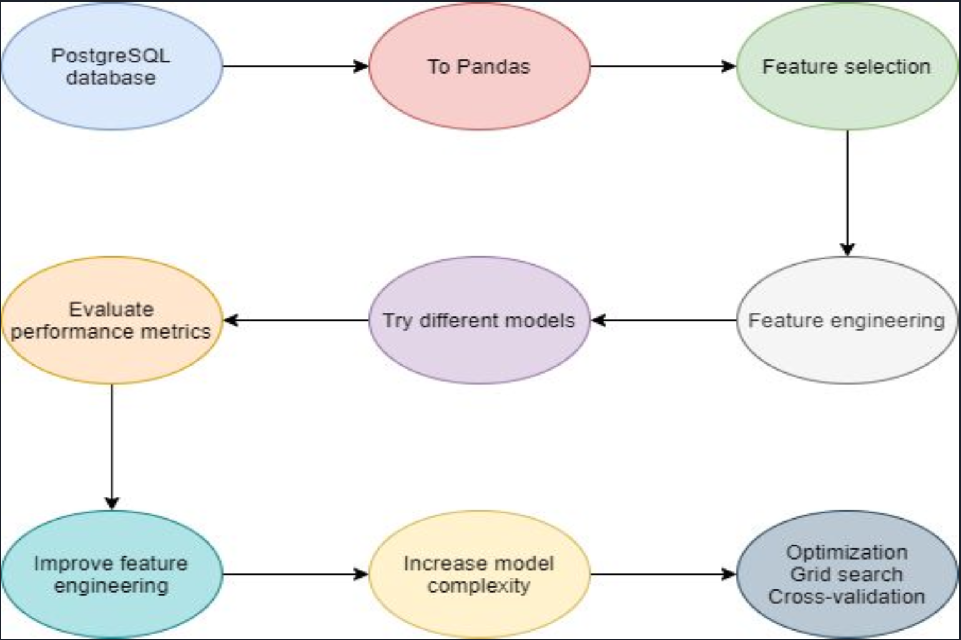
Project Workflow :
ggg statement
Company

Slide 5
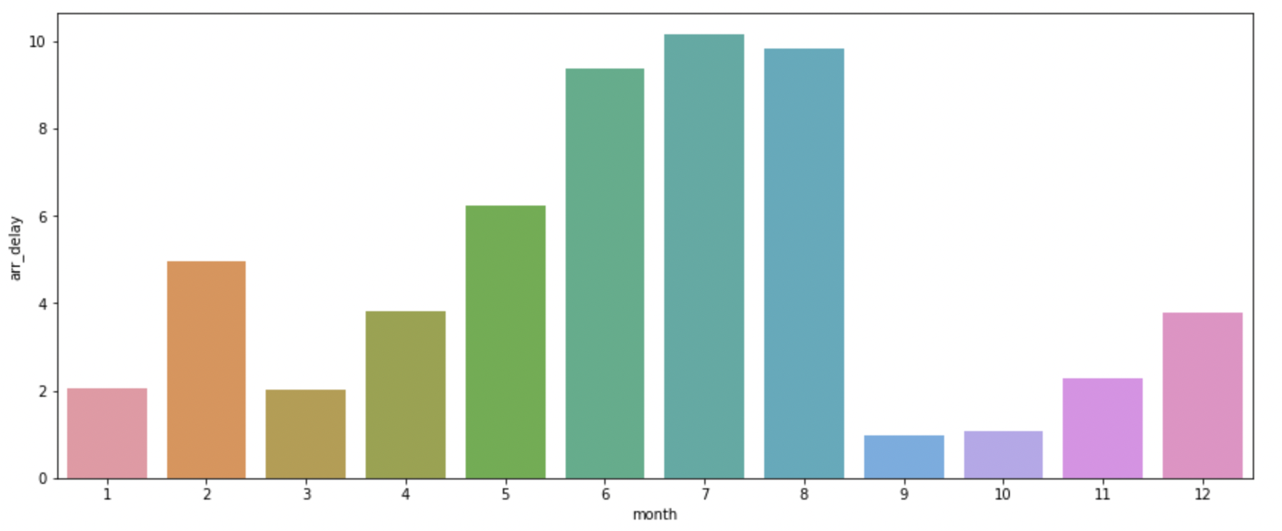
Findings from Dataset Analysis:
Arrival Delays increase during months of June, July and August as the number of travellers increase in Summer.
ggg statement
Company

Slide 6
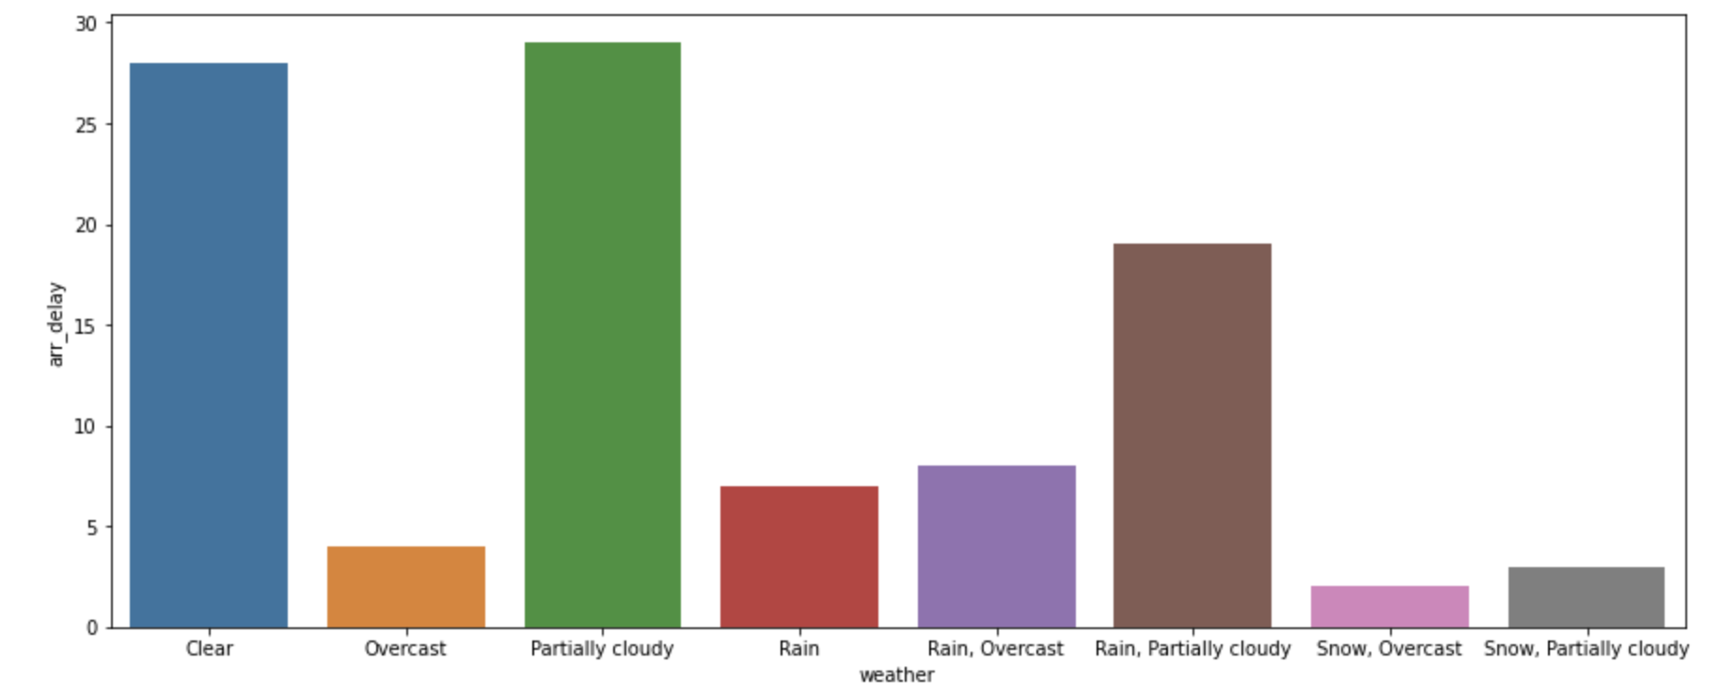
Findings from Dataset Analysis:
Based on the sample size, weather is not a significant predictor of Arrival Delays.
ggg statement
Company

Slide 7
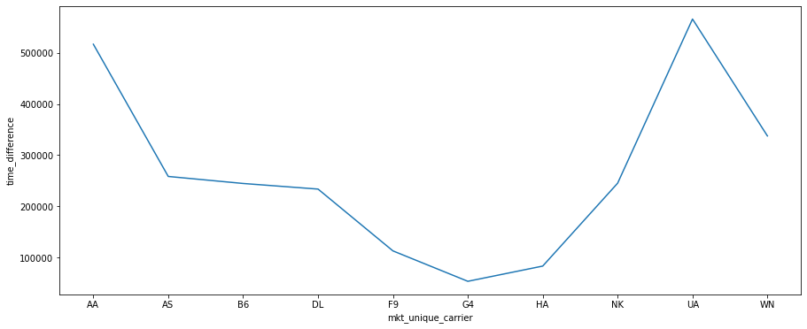
Findings from Dataset Analysis:
Upon comparing, we found that American Airlines and United Airlines have the highest amount of delayed flights.
ggg statement
Company

Slide 8
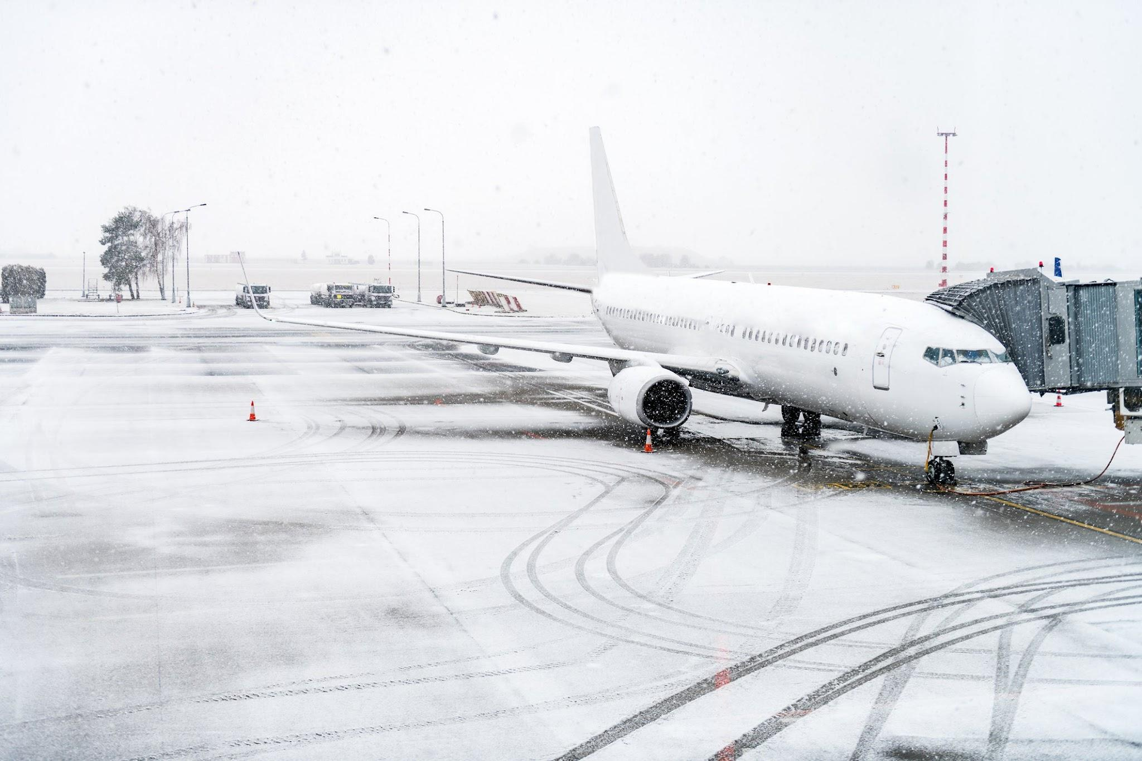
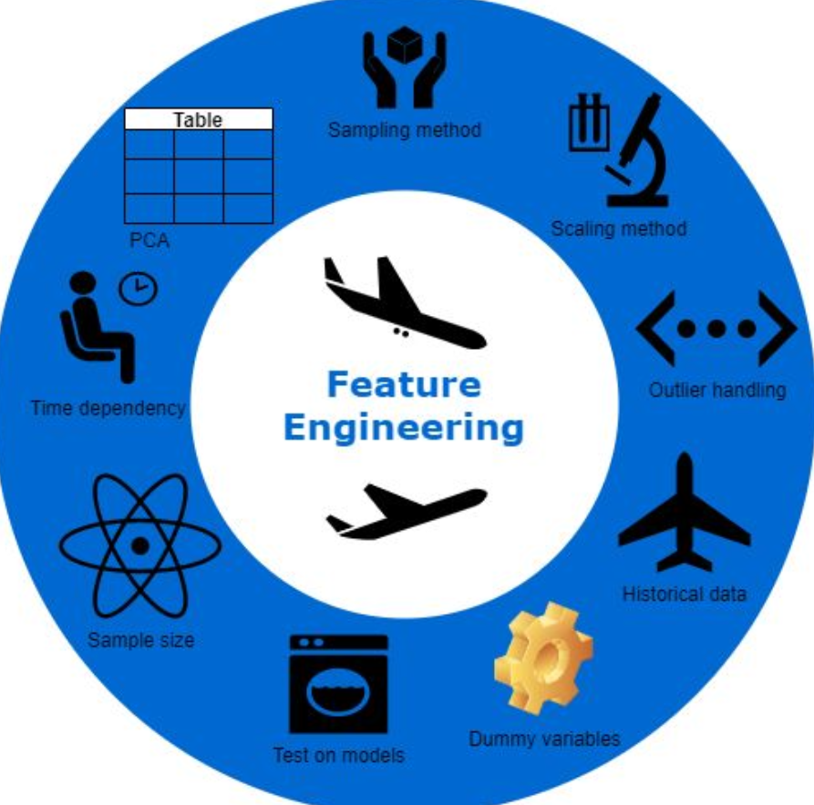
Getting Predictions One Week in Advance

Slide 9
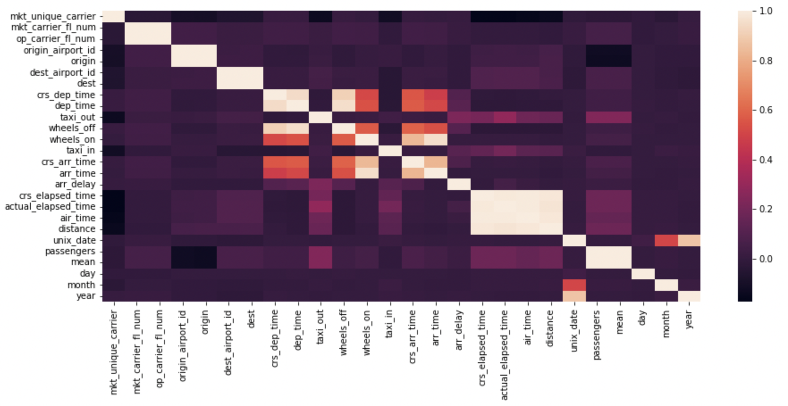
Findings from Dataset Analysis:
Analyzing correlation between features.
ggg statement
Company

Slide 10
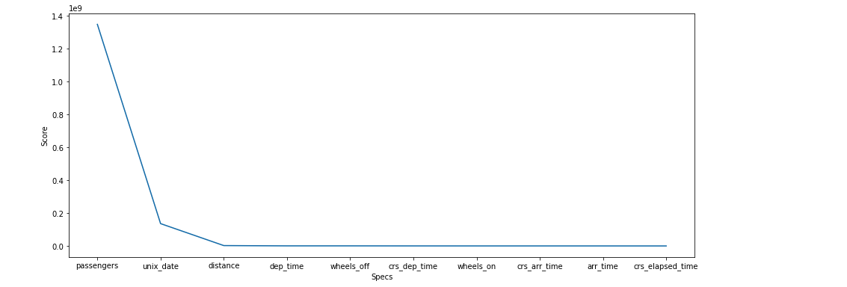
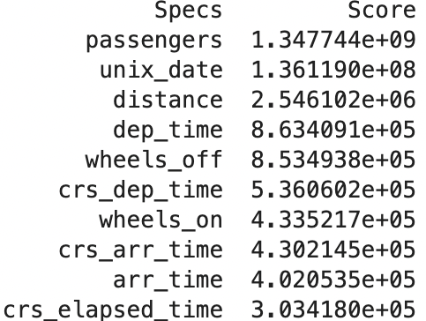
Findings from Dataset Analysis:
ggg statement
Company
Determining importance of features to predict arrival delays.

Slide 11
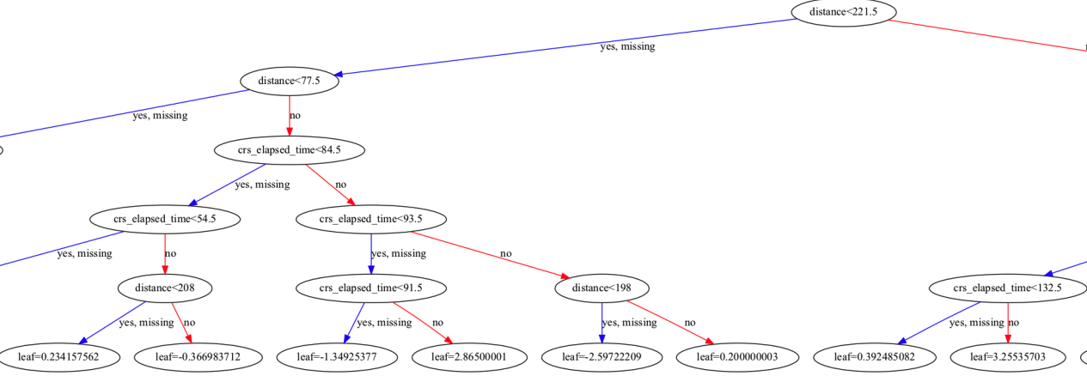
Modelling with Random Forest :

Slide 12
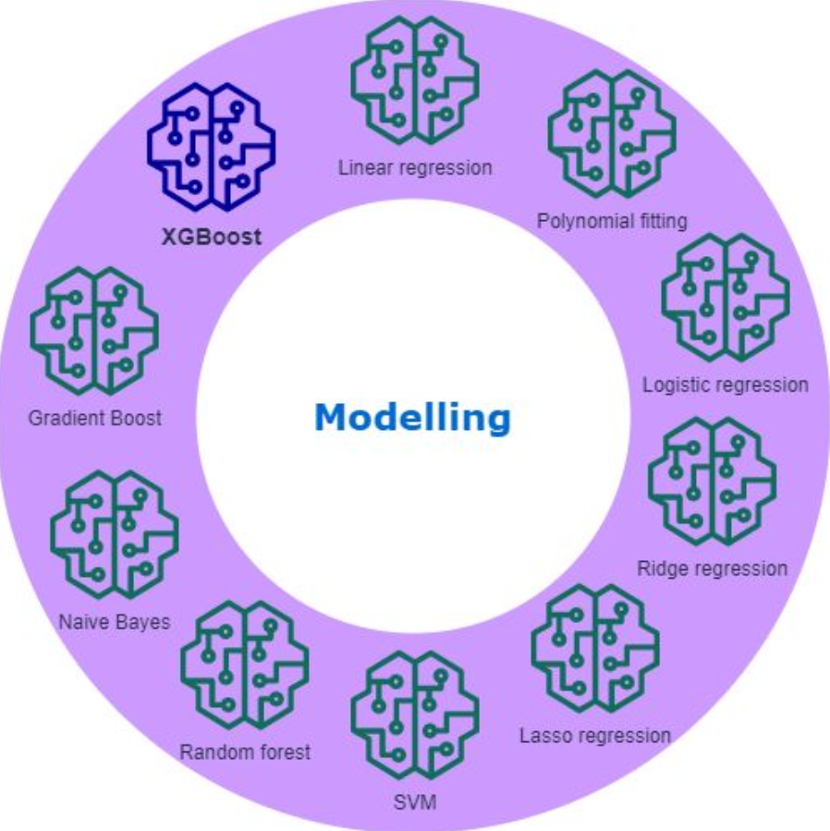

Different Models Used For Predictions :

Slide 13
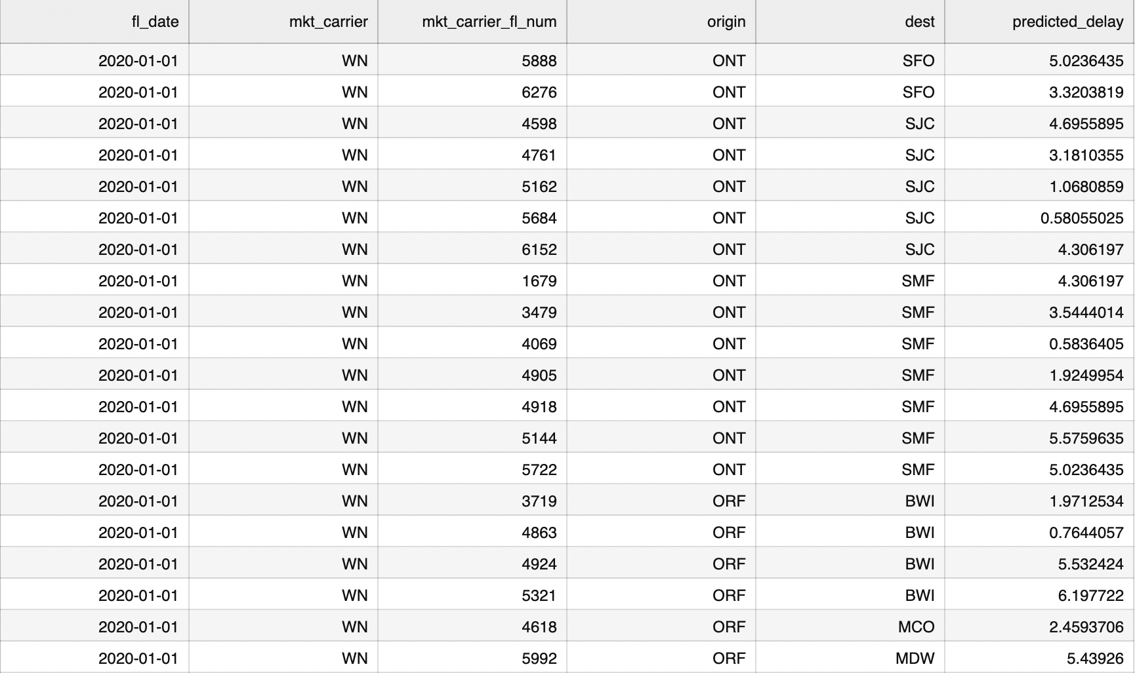
Arrival Delays Predicted One Week In Advance :
ggg statement
Company

Slide 14

Hurdles Faced & Future Goals:
Data cleaning
Feature transformation
Feature selection
Model optimisation
Multiclass Predictions
Increase model complexity
Binary Classification

Slide 15
Thank You for your time and attention.

